Slide 1

EE746 Neuromorphic Engineering Lecture 2.1: Biological Neuron
Udayan Ganguly
udayan@ee.iitb.ac.in
Aug, 10, 2023
Lectures follow Purves Chapter 1-2; Please read;
Also HW 1 is posted.
HW will take time; please do not work at the last moment.

Slide 2
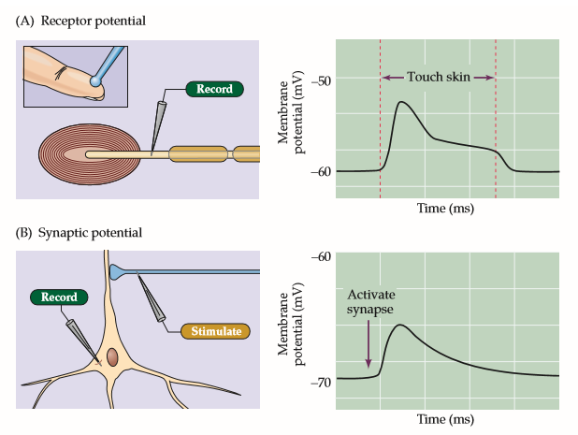
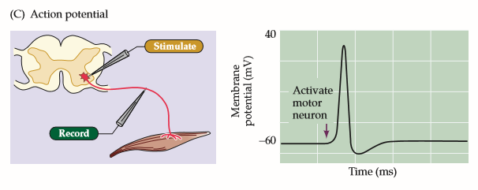
Neuronal Response
Figure 2.1 Types of neuronal electrical signals. In all cases, microelectrodes are used to measure changes in the resting membrane potential during the indicated signals.
(A) A brief touch causes a receptor potential in a Pacinian corpuscle in the skin.
Weak
(B) Activation of a synaptic contact onto a hippocampal pyramidal neuron elicits a synaptic potential.
Weak
(C) Stimulation of a spinal reflex produces an action potential in a spinal motor neuron. Booster signal to transfer signal across long axons.
Strong
Goal: How do cells produce electrical signal?
Notes:
Different types of neuronal responses are observed in nature. In the first two figures the voltage rises slightly and then comes back to its standby value. However a strong response called action potential is also observed when spinal reflect is probed. What are these signals and how do they originate ? This is what are going to study.

Slide 3
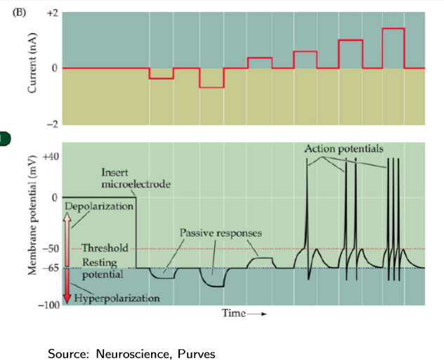
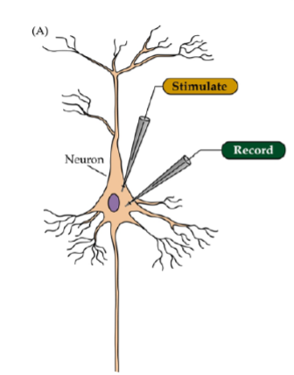
Goals
Why study neurons?
What is the resting state of the neuron?
What determines the magnitude and time evolution of spikes?
How does a spike travel along an axon?
Notes:
Hodgkin and Huxley created the first model. If we probe the neuron with current, what does it do?
For negative it follows voltage with RC constant. Nothing fancy about this! no dependence upon the magnitude of current. However with positive current, the voltage it does not saturate. After it hits a threshold it suddenly shoots up, hits peak and comes down (Action potential!). Depending upon the current it gives out different number of spikes. Spike shape has no info and it remains the same. The frequency has the information.

Slide 4
TPS: Neuron: Can you observe and guess?
1. Before things have started (Think)
(a) What happens at time t=0 for V and current?
2. After needle is pierced (Think)
(a) What happens when needle is inserted to V and I? What is the resting potential (when I=0)?
3. Negative Current (Pair)
(a) What happens during low negative current? How does it change with high positive current?
(b) Do we know what is the approximate circuit equivalent from this response?
4. Positive Current (Pair)
(a) What happens in the low positive current?
(b) How does response change with higher current?
(c) What sort of device is it based on input output transformation function
(d) Does the negative current circuit model work?
(e) What more does the positive current circuit need to capture? You dont need to design the circuit of course...
Observe and guess the “model”

Slide 5
TPS: Neuron: Can you observe and guess?
1. Before things have started (Think)
(a) What happens at time t=0 for V and current?
2. After needle is pierced (Think)
(a) What happens when needle is inserted to V and I? What is the resting potential (when I=0)?
3. Negative Current (Pair)
(a) What happens during low negative current? How does it change with high positive current?
(b) Do we know what is the approximate circuit equivalent from this response?
4. Positive Current (Pair)
(a) What happens in the low positive current?
(b) How does response change with higher current?
(c) What sort of device is it based on input output transformation function
(d) Does the negative current circuit model work?
(e) What more does the positive current circuit need to capture? You dont need to design the circuit of course...
Observe and guess the “model”

Slide 6
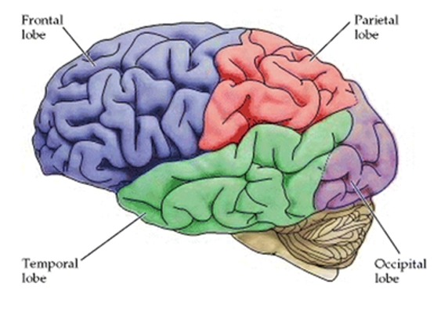
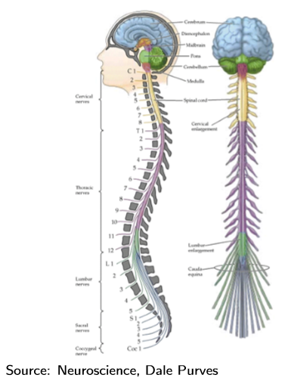
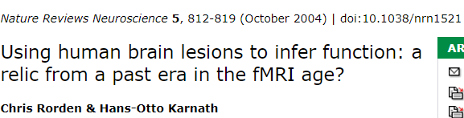
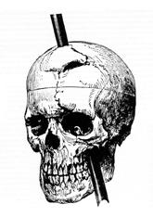
Nervous System
Frontal lobe - Reasoning, motor skills, cognition, language
Parietal lobe - pressure, touch, and pain
Temporal lobe - sounds, memory
Occipital lobe – vision
Each location specializes to a function
Phineas Gage Accident
Notes:
https://en.wikipedia.org/wiki/Functional_specialization_(brain)
https://en.wikipedia.org/wiki/Phineas_Gage
Phineas Gage became one of the first lesion case studies in 1848 when an explosion drove a large iron rod completely through his head, destroying his left frontal lobe. He recovered with no apparent sensory, motor, or gross cognitive deficits, but with behaviour so altered that friends described him as "no longer being Gage," suggesting that the damaged areas are involved in "higher functions" such as personality.^{[3]} However, Gage's mental changes are usually grossly exaggerated in modern presentations.
Subsequent cases (such as Broca's patient Tan) gave further support to the doctrine of specialization.
“A child in his intel­lec­tu­al capacity and man­i­fes­ta­tions, he has the animal passions of a strong man.”
Broca’s Patient Tan
Using Brain Lesions to Infer Function
https://www.nature.com/articles/nrn1521
https://blogs.scientificamerican.com/literally-psyched/the-man-who-couldnt-speakand-how-he-revolutionized-psychology/

Slide 7
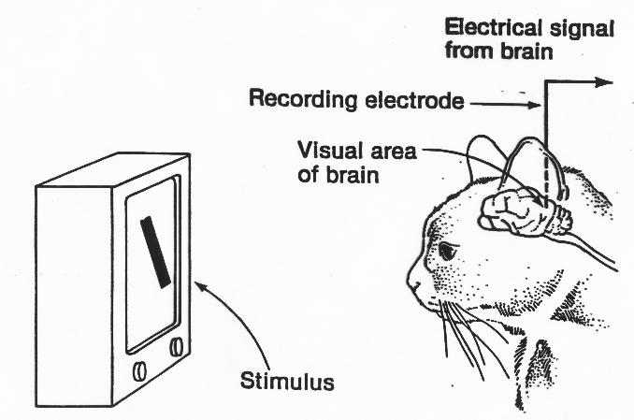
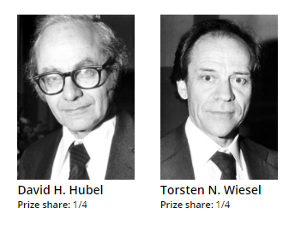
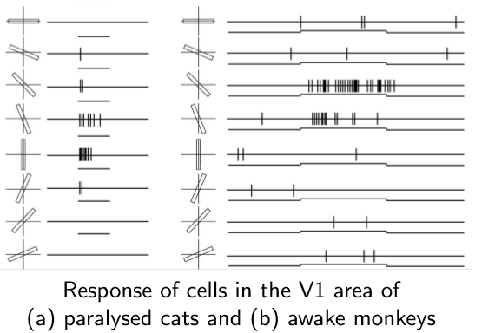
Representation of Information: Details
The Nobel Prize in Physiology or Medicine 1981
"for their discoveries concerning information processing in the visual system".
How does the brain recognize- as a whole (Gestalt psychologists)
or does it deconstruct into simpler “alphabets”?
e.g. Chinese characters
This shows a hierarchical structure
Notes:
This experimental revealed selective training in the neurons. A cat is shown images of sticks with different inclinations. The spiking activity in one of its neuron is recorded and plotted. Particular neuron responds for particular orientation. The spike rate can be seen to decrease when the inclination moves out of the field of response. With many neurons tuned to particular inclination we get image perception.
For more details about Hubel Wiesel experiment, please read the following
https://en.wikipedia.org/wiki/David_H._Hubel
Hubel and Wiesel received the Nobel Prize for two major contributions: firstly, their work on the development of the visual system, which involved a description of ocular dominance columns in the 1960s and 1970s; and secondly, their work establishing a foundation for visual neurophysiology, describing how signals from the eye are processed by visual parcels in the neo-cortex to generate edge detectors, motion detectors, stereoscopic depth detectors, and color detectors, building blocks of the visual scene

